Slide 1
BCB546X – Group Project Presentation
Department of Bioinformatics and Computational Biology
Amy Pollpeter
Elena-Qiuhan Jiang
Kelby Kies Rocks
Zach Lozier

Slide 2
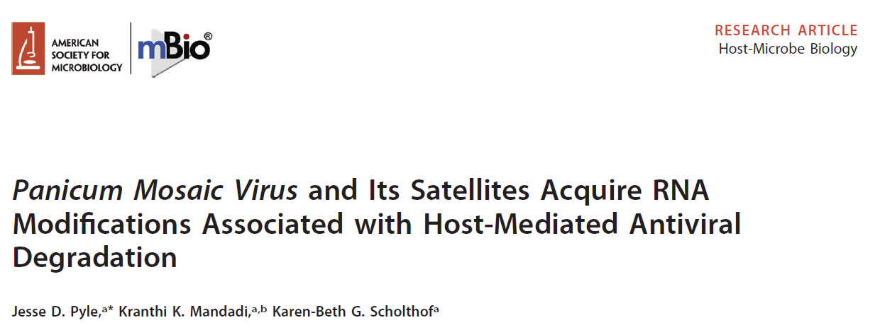
Paper Chosen
A
July/August 2019 Volume 10 Issue 4 e01900-19
Bioinformatics and Computational Biology

Slide 3
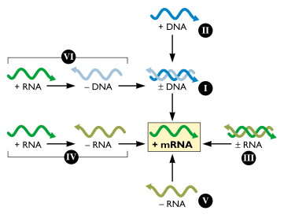
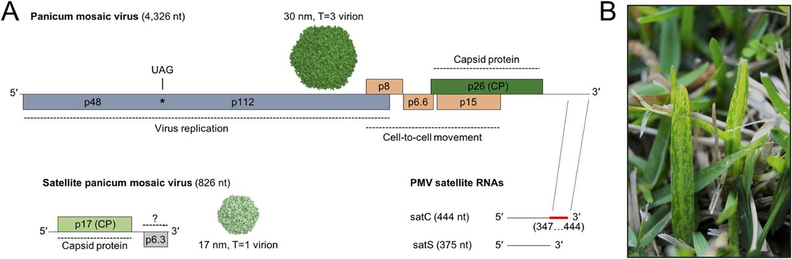
Background
Z
http://www.virology.ws/2009/08/12/simplifying-virus-classification-the-baltimore-system/
Bioinformatics and Computational Biology

Slide 4
https://www.ncbi.nlm.nih.gov/pmc/articles/PMC4863231/figure/F1/
Z
Overview of the experiment
1. Isolate RNA from samples.
2. Purify RNA of interest with poly-A tail
3. Generate cDNA
4. Construct Sequencing library
5. Downstream Analysis
Bioinformatics and Computational Biology

Slide 5
Why we chose this paper:
A
Not well documented
Big Implications for their results
Didn’t use a typical read mapping software
Bioinformatics and Computational Biology

Slide 6
Their Bioinformatics Pipeline
A
Sequenced Samples
Counted Reads
BLAST
Seq Data = Database
Ref Genome = Query
Assembled into contigs with CodonCode Aligner
Use Contigs as Query for megablast
Bioinformatics and Computational Biology

Slide 7
How we attempted to replicate their pipeline:
A
Download Data using their Accession numbers.
Count Reads
Blast Reads
Tabulate Results and Compare to Table S1
(see results slide)
Assembled into contigs with CodonCode Aligner
Use Contigs as Query in Megablast
fasterq-dump
wc -l
blastn
megablast
dc-megablast
grep
Bioinformatics and Computational Biology
Notes:
Ran all three to see which captured the most reads

Slide 8
Comparison of Results
A
Discontinuous
Blast
Blast – N
MegaBlast
Database | Query | Their Reads | Our Reads
Mock | PMV | 5 | 5
Mock | SPMV | 0 | 0
PMV | PMV | 20,000 | 21654
PMV | SPMV | 0 | 0
Combined | PMV | 19928 | 19891
Combined | SPMV | 763 | 755
Their Reads | Our Reads
5 | 5
0 | 0
20,000 | 21654
0 | 0
19891 | 19891
755 | 755
Their Reads | Our Reads
5 | 5
0 | 0
20,000 | 21691
0 | 0
19917 | 19891
759 | 759
Bioinformatics and Computational Biology

Slide 9
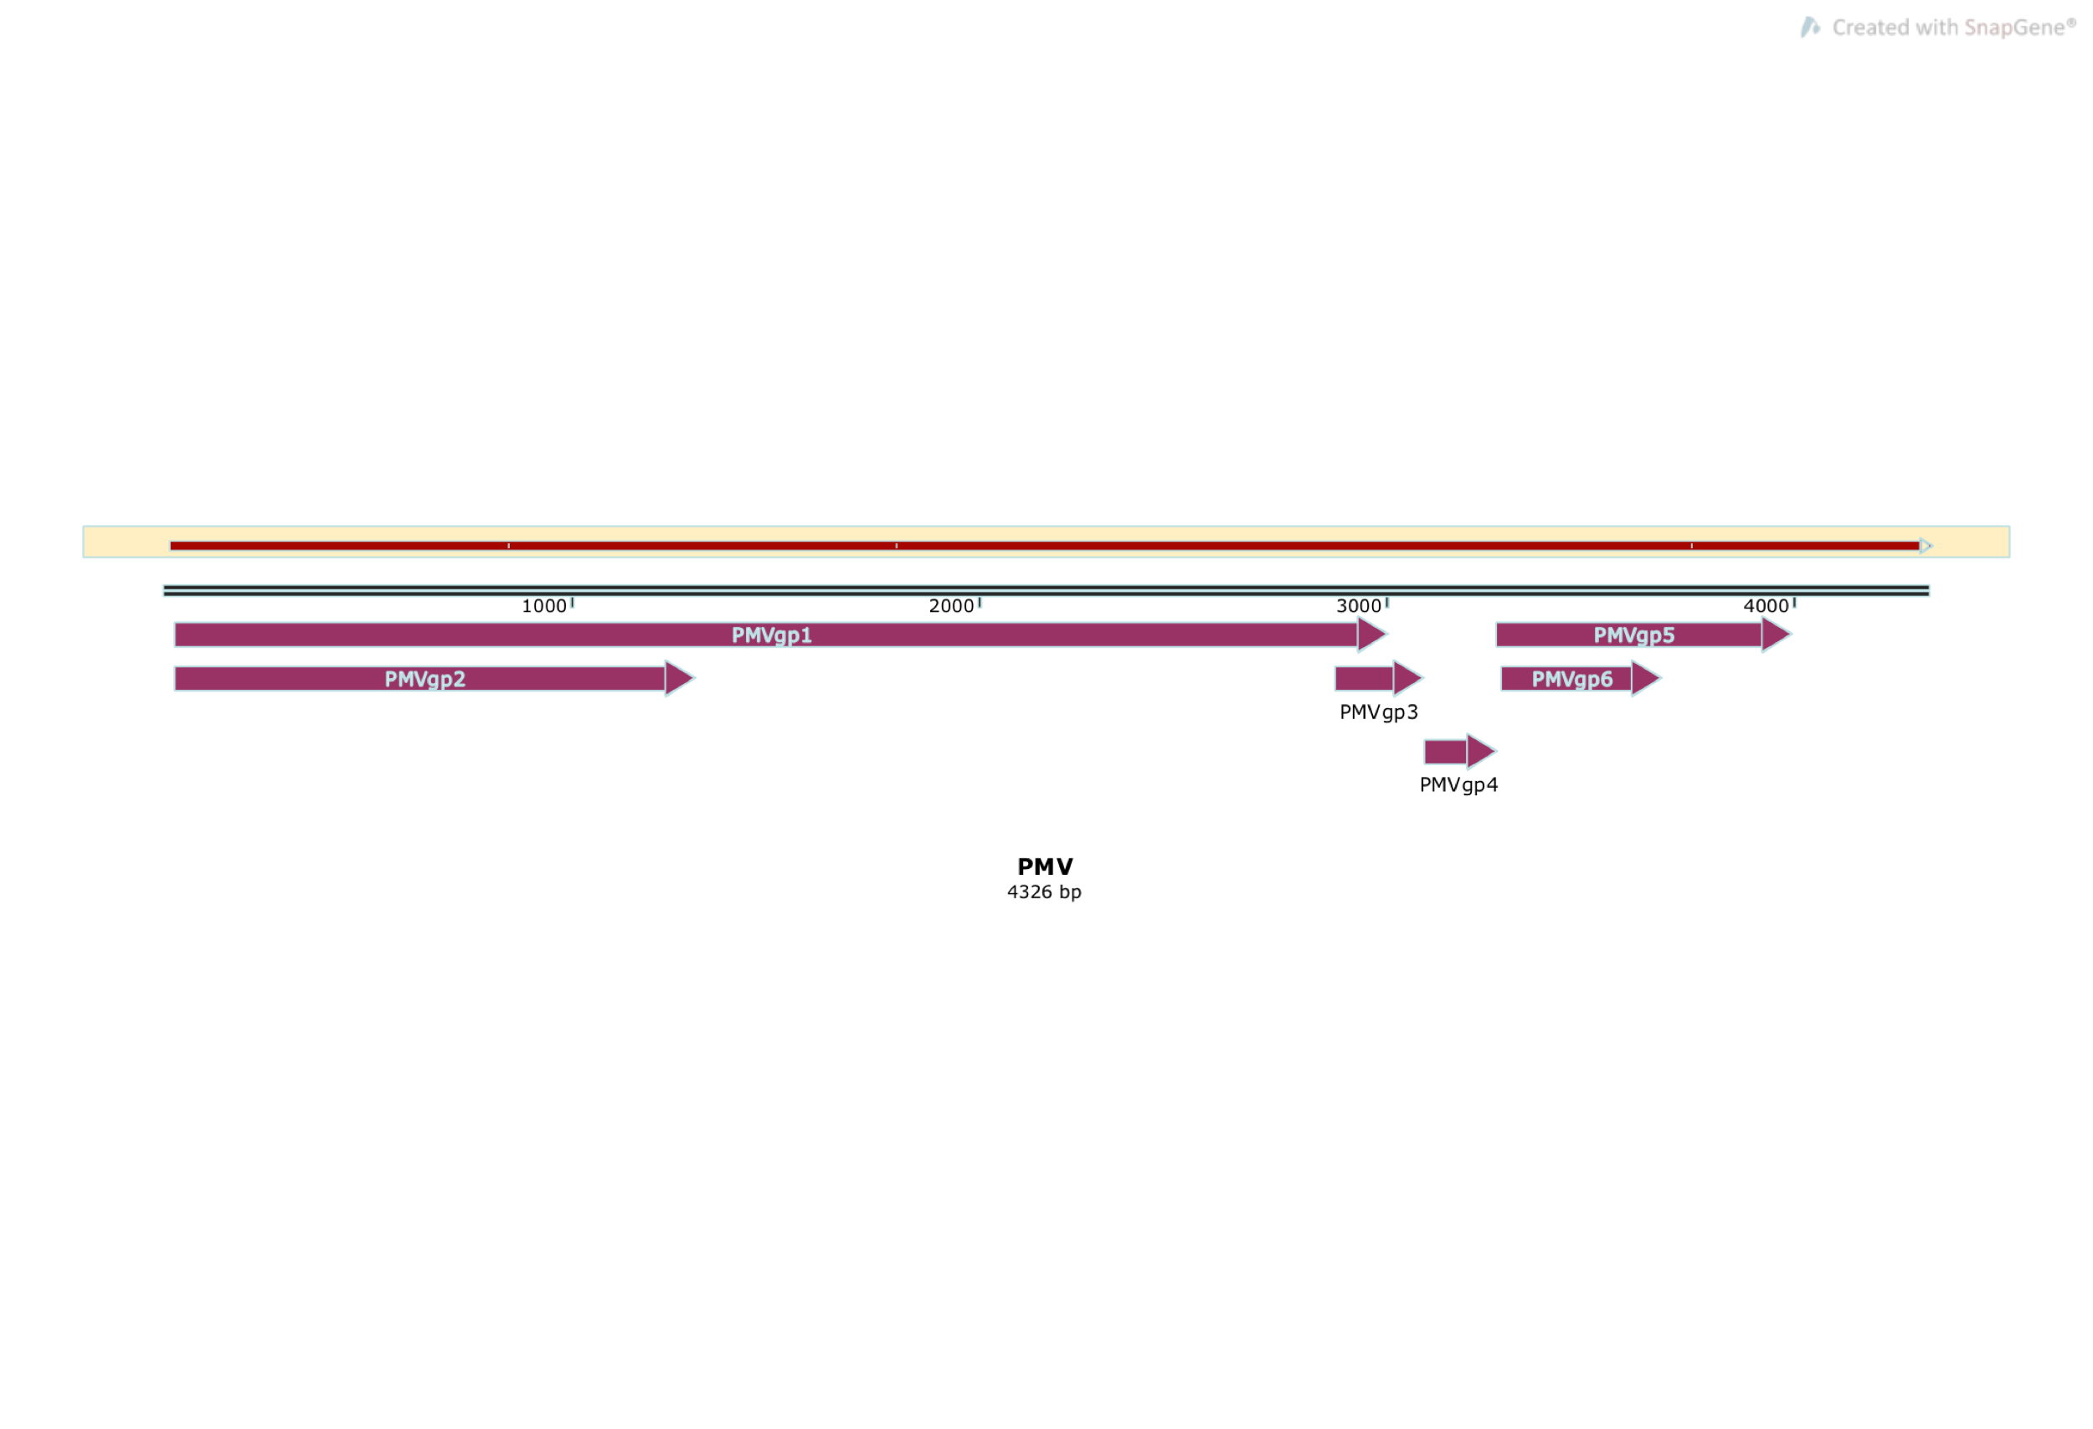
E
Pairwise Alignment
Codon Code Aligner found 8 A’s at the 3’ end
PMV PMV Contig
5’
3’
PMV Reference Genome
Bioinformatics and Computational Biology
Notes:
This is a pairwise alignment between PMV contig to PMV reference genome. Preliminary observations demonstrated that poly(A) forms of the PMV and SPMV genomes are present within their transcriptomes. The first line here shown in the graph is the PMV contig. The second line here shown in the graph is the PMV reference genome, both from 5’->3’ direction. There is a 5’ end extension of viral genome, probably due to the artifact of contig assembly process.
The 3 mutations/mismatches could be an artifact of RNA sequencing. Alternatively, it could be valid mutations in the genome that occurred during PMV replication in plant and whose functional consequences remain to be determined. The contig contains 8 bases of A’s at the 3’end, compared to none in the PMV reference genome.

Slide 10
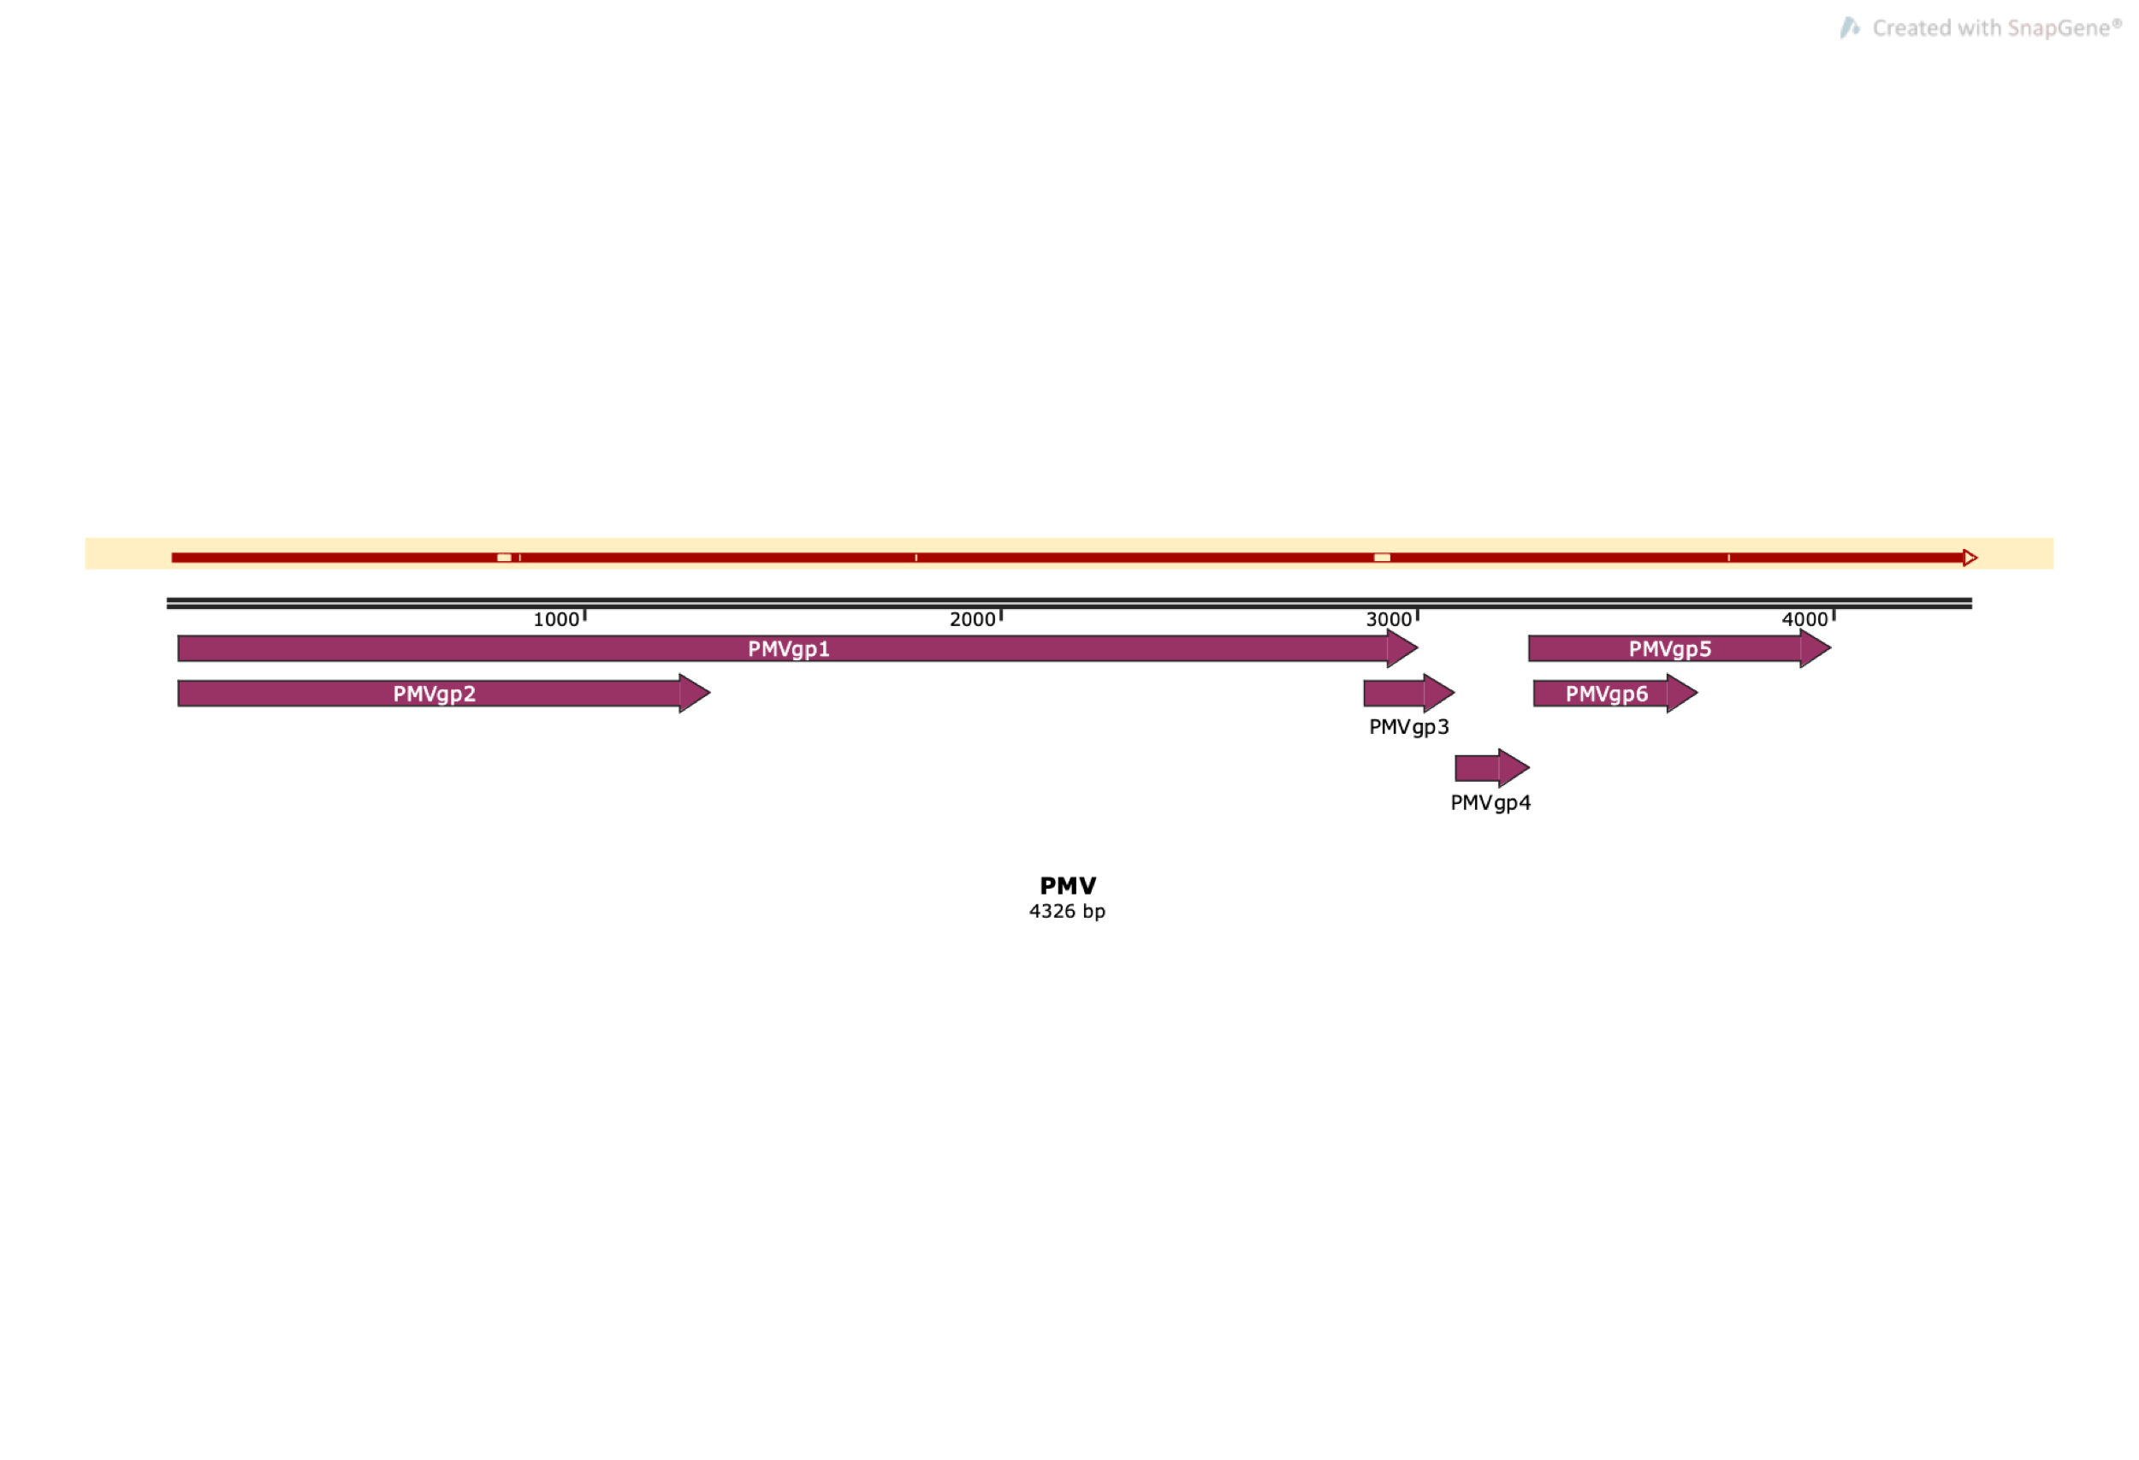
E
Pairwise Alignment
Codon Code Aligner found 14 A’s at the 3’ end
Combined PMV Contig
5’
3’
PMV Reference Genome
10
Bioinformatics and Computational Biology
Notes:
Here is the pairwise alignment between PMV-SPMV contig compared to PMV reference genome. Again, the 4 mutations/mismatches could be an artifact of RNA sequencing. Alternatively, it could be valid mutations in the genome that occurred during PMV replication in plant and whose functional consequences remain to be determined. The contig contains 14 bases of A’s at the 3’end, compared to none in the PMV reference genome.

Slide 11
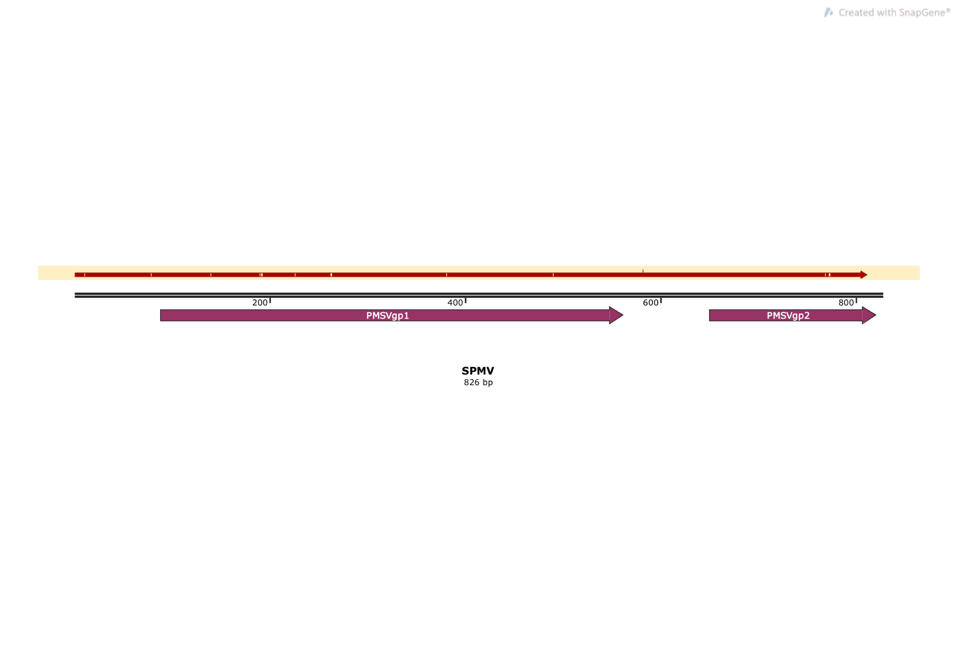
E
Pairwise Alignment
Codon Code Aligner found 0 A’s at the 3’ end
Combined SPMV contig
5’
3’
SPMV Reference Genome
Bioinformatics and Computational Biology
Notes:
Here is the pairwise alignment of PMV-SPMV compared to SPMV reference genome. The SPMV contig was 10 bases longer than the SPMV reference sequence and contained many mutations throughout the genome, including multiple deletion and substitution events. The contig did not contain any stretch of adenine residues at the 3’ end. These differences may be explained by the relatively low number of reads identified and used for generation of SPMV contig relative to the reads identified for PMV.

Slide 12
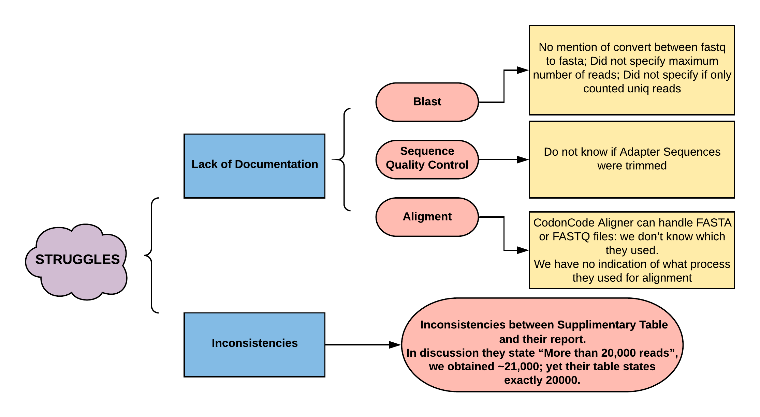
E
Bioinformatics and Computational Biology

Slide 13
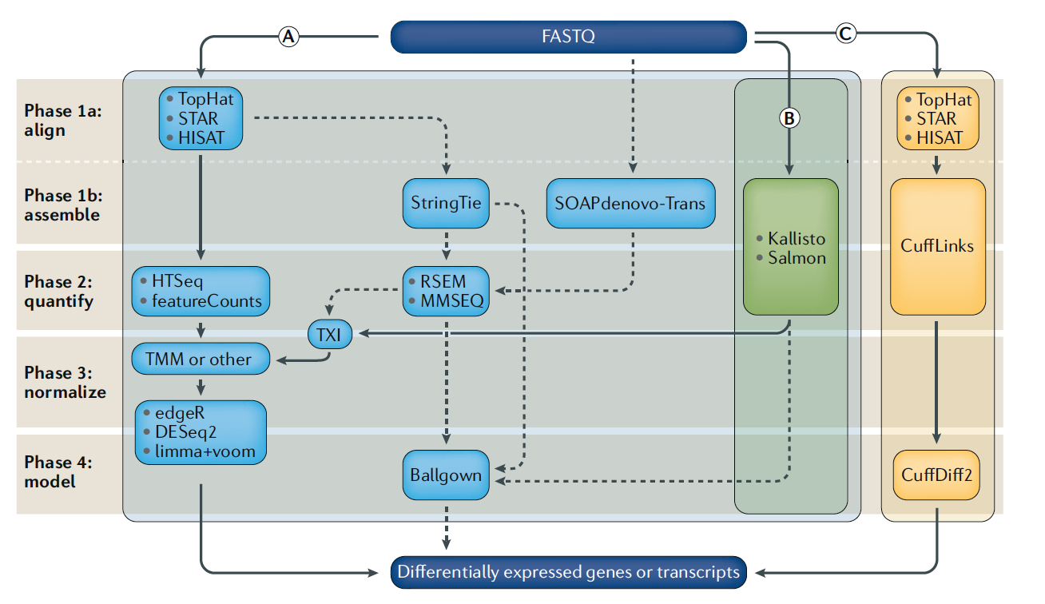
More Typical Pipelines for RNAseq data
K
13
Bioinformatics and Computational Biology
Notes:
https://www.nature.com/articles/s41576-019-0150-2
It’s important to understand that there is not one standard pipeline. The chosen pipeline depends on the research question asked and the species.
This figure is being applied to study the expression of genes. Our paper isn’t investigating that. Our paper is using RNAseq to study the modifications that genomic RNAs of Panicum mosaic virus (PMV) and its satellites undergo

Slide 14
Potential alternate Pipeline:
K
RNA Sequencing
Quality Control – Fast QC
Trim Reads – Trimmomatic
Filter Host Reads – Hisat2
Non-host Reads
De novo assembly – Trinity
Map to Viral genome(s) – Bowtie2
Bioinformatics and Computational Biology

Slide 15

Questions?

